Slide 1
Desktop Object Identification and Tracking
Kevin DuCharme &
Max Li
Notes:
Hello and welcome all to our presentation. We are Kevin and Max and today we will be talking to you about out project, desktop object identification and tracking.

Slide 2
Introduction

Slide 3
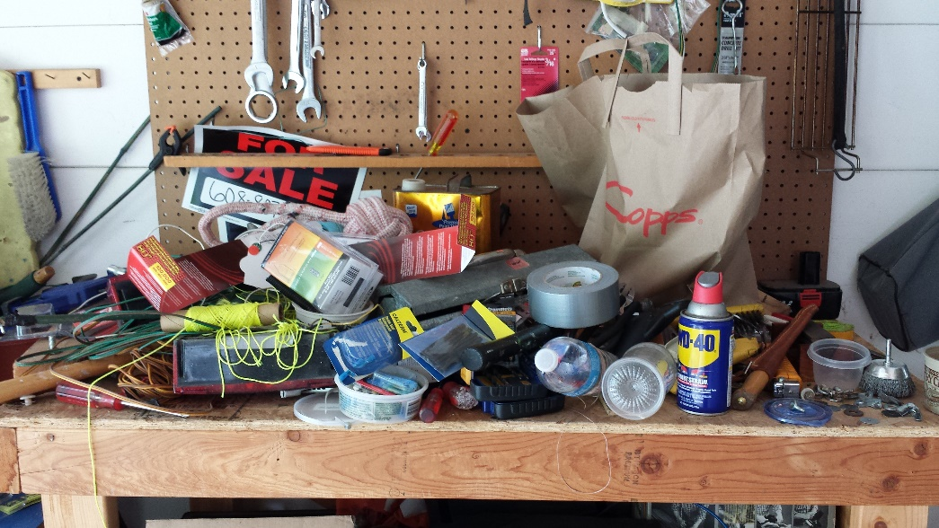

Motivation
The main motivation behind this project is the struggle of finding items on a heavily used desk. On an active workbench, tools and other useful items are frequently getting picked up, used, and placed down somewhere else. While good standard operating procedures will make sure all the parts end up where they're expected to be, it's very easy to quickly lose track of items.
Notes:
The main motivation behind this project is the struggle of finding items on a heavily used
desk. On an active workbench, tools and other useful items are frequently getting picked
up, used, and placed down somewhere else. While good standard operating procedures will
make sure all the parts end up where they're expected to be, it's very easy to quickly lose
track of items.

Slide 4
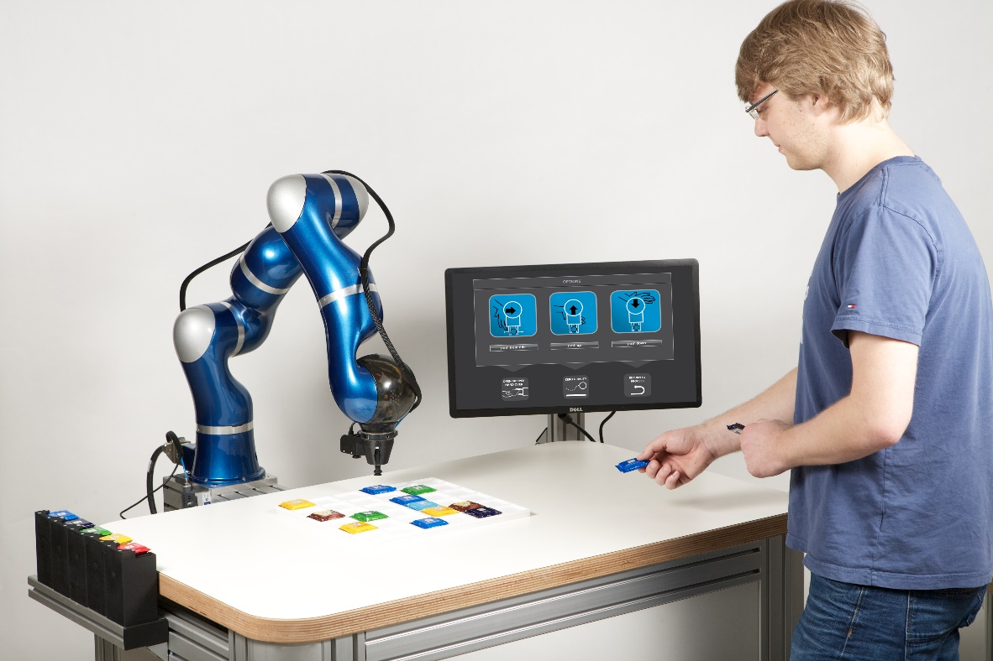
Introduction
Starting the framework for a lab assistant robot
Detect and track pre-trained common workbench items
Notes:
The goal of this project is to start the foundation of a lab assistant robot that has the
capability of tracking common items found on a workbench in pseudo real-time. When a
user queries the robot, it should be able to tell the user where a specific tool is, in a way
that would make sense to the user. Initially, the objects being identified would come from
a preset bank of objects that have been pre-trained. However, the end product will likely
have to be trainable on new objects by the user.
For this project, the main topic of focus is object tracking. After all, the rest of the
features are both fairly difficult (and thus time-consuming), and out of scope of the computer
vision task. As such, the goal is to be able to detect a number of different objects, identify
what they are, and track them as they move across a camera.

Slide 5
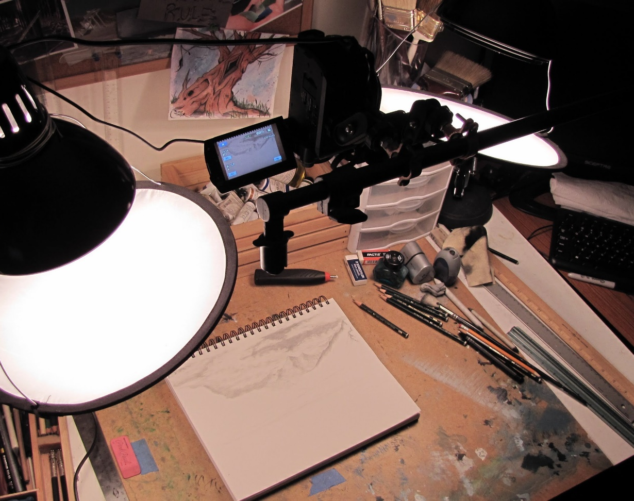
Desk Camera Configuration
Controlled Environment
Keep setup simple
Top-down viewing camera
Kept well-lit
Reduced clutter for initial implementation
Notes:
We wanted to control our environment to ease our ingress into the world of computer vision using deep learning networks. While later on this network can be refined to better handle clutter and various lighting conditions, we wanted to remove those distractions so that we could focus on the object detection and tracking aspect.

Slide 6
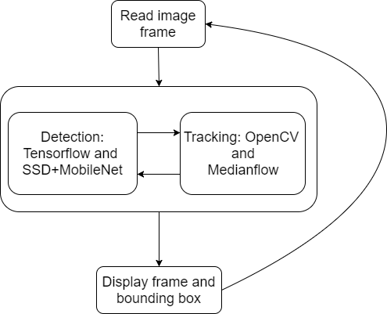
Code Structure
Python 3.5
Tensorflow 1.4
OpenCV 3.3 with extra modules (opencv-contrib)

Slide 7
Object Detection

Slide 8
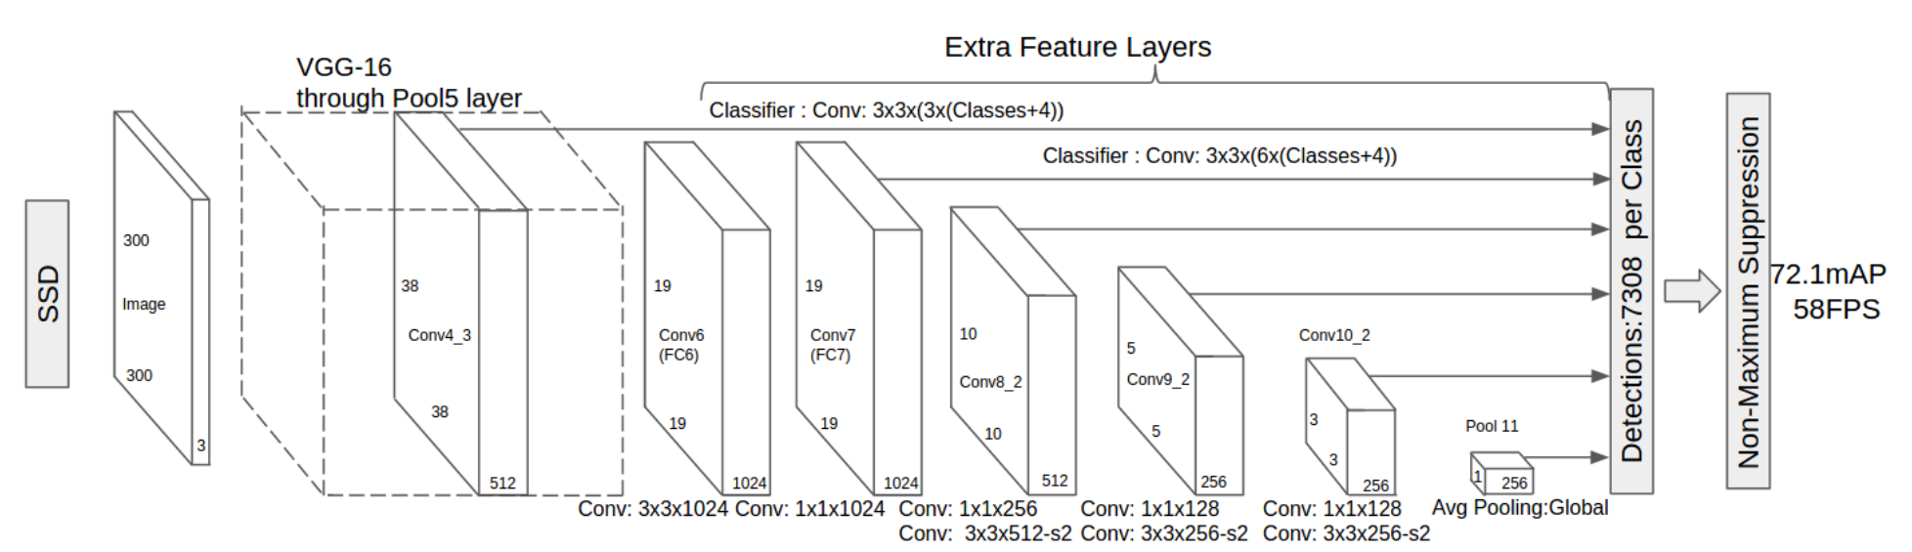
Single-Shot Detectors
Notes:
Single-shot detectors provide for faster detection at the cost of accuracy. It is a tradeoff worth making though for our pseudo ‘real-time’ application.
One of the reason why they gain their speed is because the input images are resized to a smaller resolution. This allows the different convolution layers that have multiple scaled feature maps to work through them quickly. The varied feature maps also help with handling objects with different sizes. Lastly, they are easy to train.

Slide 9
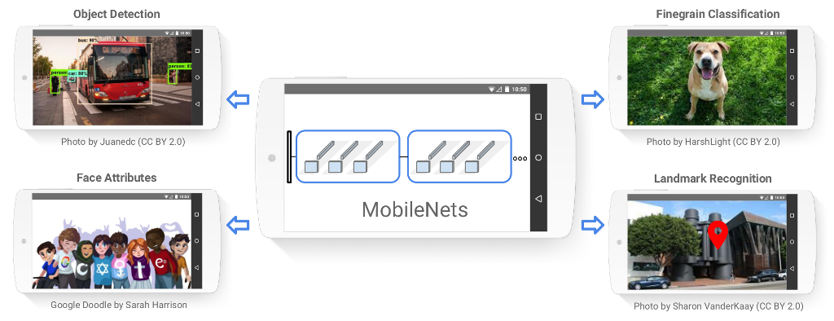
MobileNets
A. G. Howard et al, "MobileNets: Efficient Convolutional Neural Networks for Mobile Vision Applications," 2017.
Notes:
Google Inc. developed and announced MobileNets, a class of efficient models for mobile and embedded vision applications. It achieves this efficiency by using depth wise separable convolutions to build light weight deep neural networks.
The streamlined architecture brings applications like object detection and landmark recognition off of computers and onto lower resource devices like phones.
This approach falls inline with our intention to target a raspberry pi in the future.

Slide 10
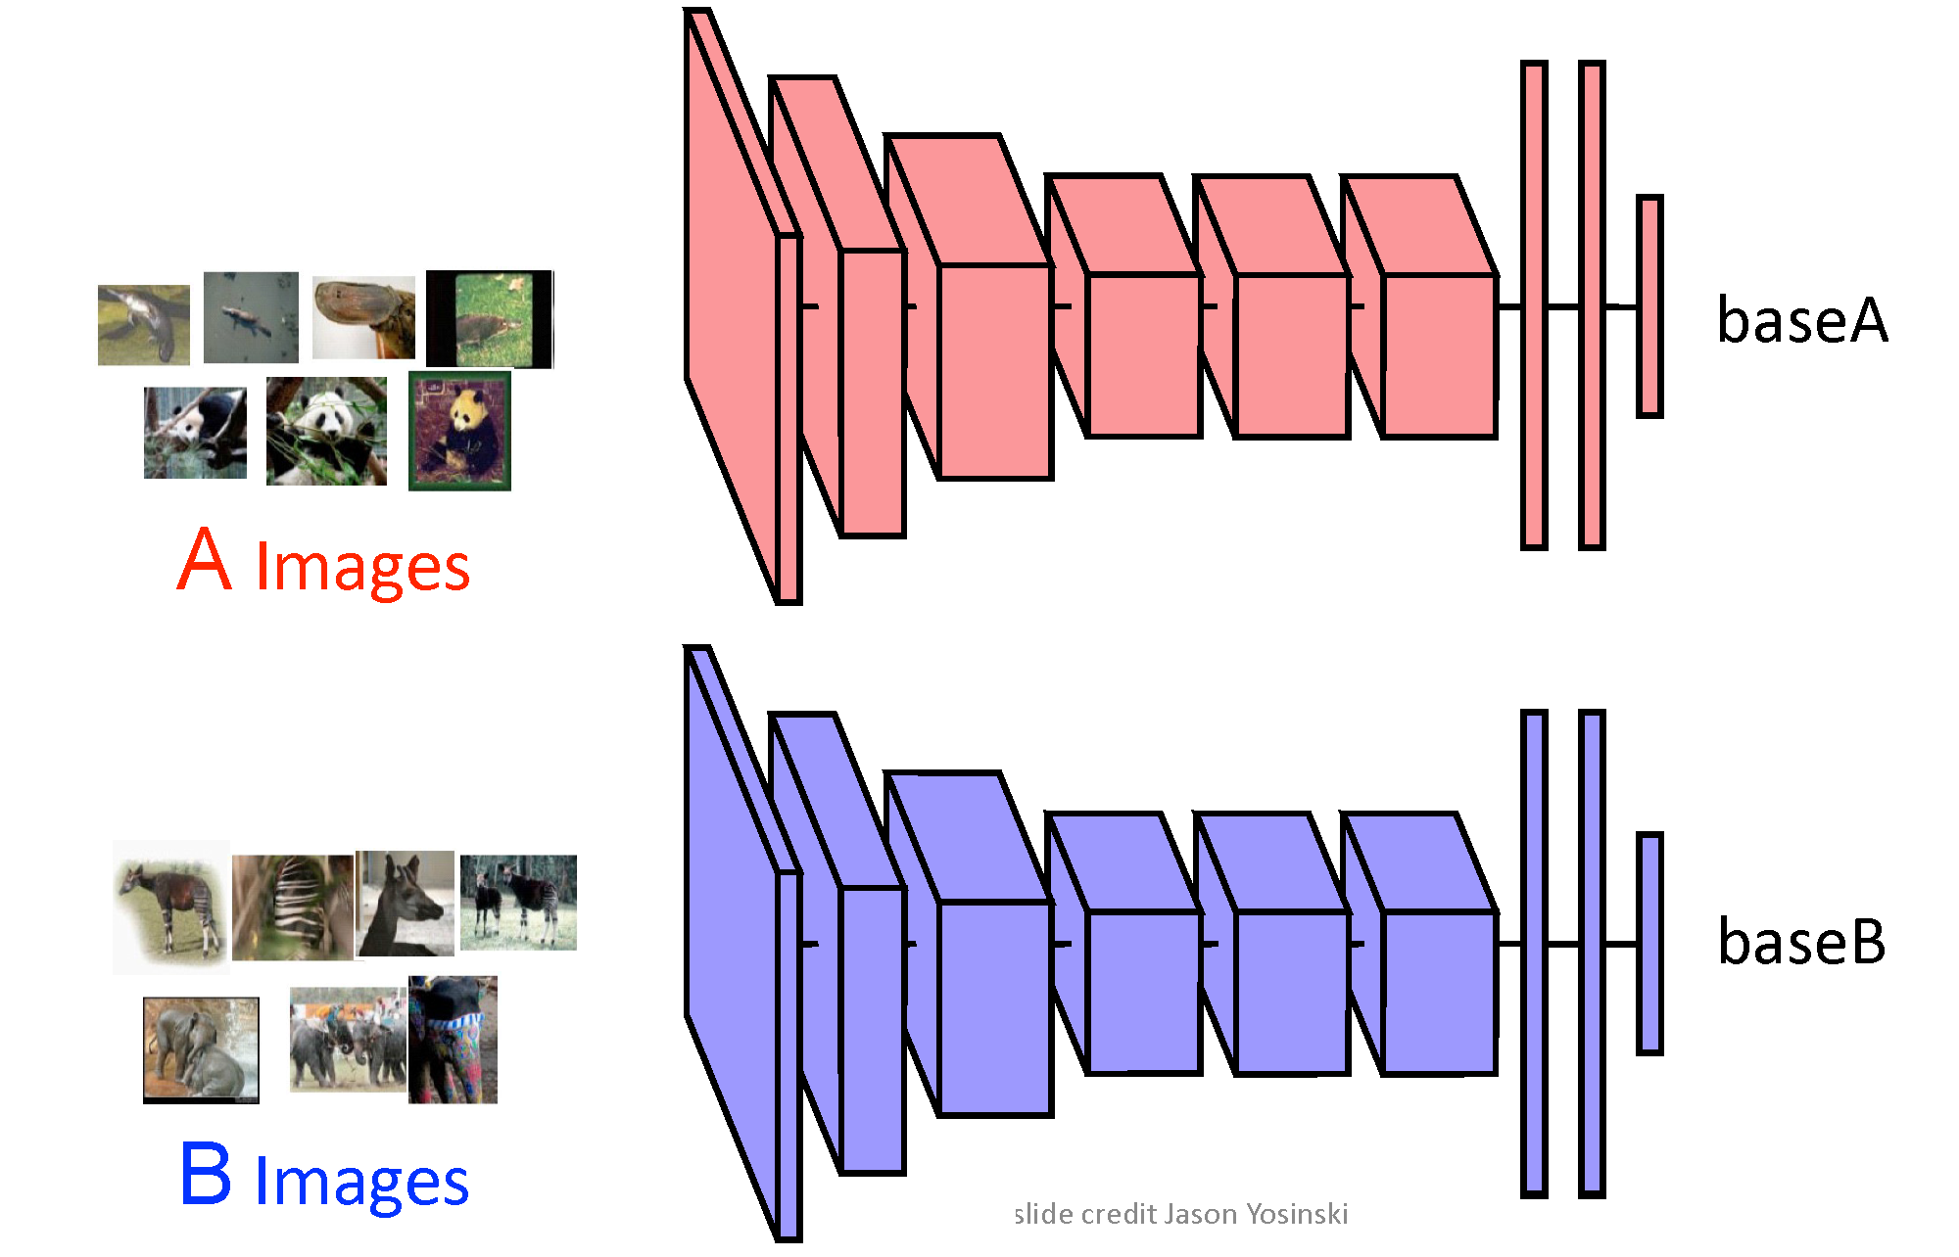
Transfer Learning
Notes:
Like many other applications in coding, neural networks are designed perfectly for reuse or transfer learning. Most deep learning applications use this approach instead of building a network from scratch every time.
The process consists of making modifications to pretrained models. Transfer learning can consist of reusing a single layer up to the whole network.
The network that we will be employing was trained on the COCO image dataset. We are reusing the entire structure, but changing the output layer for only 3 classes. The model has already defined feature details and a weight file that helps us load new images in and train for a fraction of the time to get our new output predictions.

Slide 11
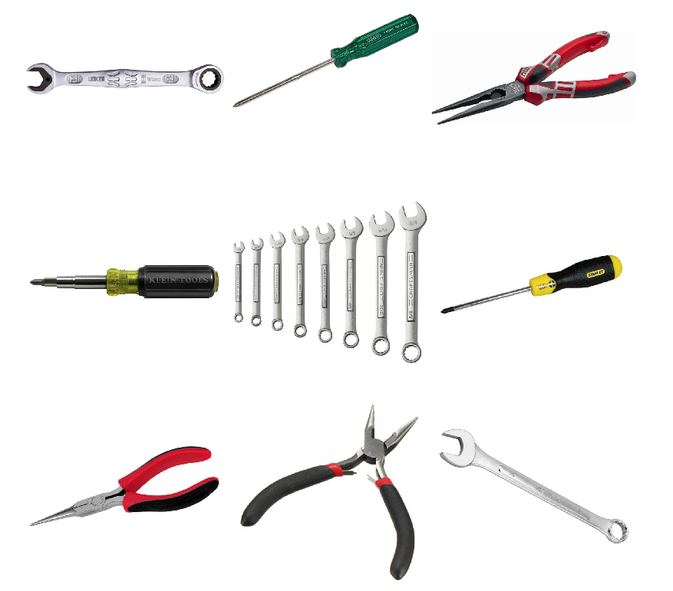
Gathering Training Set
The project was limited to three classes: Wrenches, Pliers, and Screwdrivers.
Each category contains ~150 sample images
Images are of various resolutions
Only data augmentation was scaling down high resolution images
Notes:
Creating your own dataset can be a time consuming and arduous process and because of that we limited this project to three classes: Wrenches, Pliers, and Screwdrivers. Using a combination of Google and Bing image searches, along with image-net.org, about 150 sample images was collected for each class. The images had a wide range of resolutions which helps with providing robustness to the trained model. During training, we did run into some memory issues due to some of the ridiculously large image resolutions. I am not sure who needs a 4k x 4k image of a pair of pliers, but our computers where none too happy with it. Instead of reducing our samples by removing the images, we resized the images down to something more manageable.

Slide 12
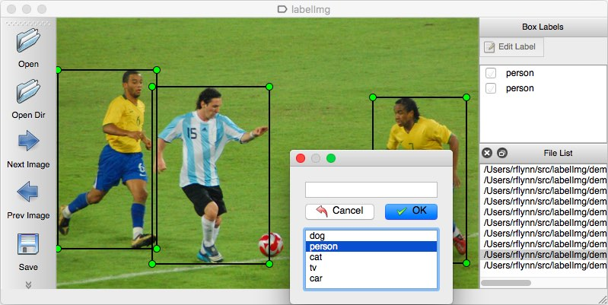
Bounding Box Labels
LabelImg (github/tzutalin)
Boundary box information was added for each item
Label was applied to the boundary box
Resulting XML files are converted to a tensorflow record file.
Tf.record
XML
Notes:
After we have our image dataset comes the tedious part - Labels and Boundary Boxes. The boundary boxes are used for regression training as ground truths to calculate Euclidean distances.
To generate these bounding boxes, we made use of LabelImg to open each photo, draw a box around the object, and then classify it. LabelImg then creates an xml file that contain the locations, sizes, and classification label for each box. In order to import these files by tensorflow, they are converted to tensorflow record files.

Slide 13
Training New Model
To train the model with the new data set four files were needed
tf.record file for each the training and testing dataset
.pbtxt file which maps the id number to a classification label
.config which contains the architecture for the neural network
Configuration file was based off of ssd_mobilenet_v1_pets.config with alterations
Changes number of classes from 90 to 3
Batch sized changes from 24 to 15
Redirected to our tf.record files and label map pb.txt file
Training ran for 13+ hours and completed 30,857 steps
tf.record
.pbtxt
.config
Notes:
Along with the tensorflow record files, we will also need a pbtxt file and configuration file.
The pbtxt file is used to link the id number from the neural network to a classification label.
Our classification labels of Wrenches, Pliers, and Screwdrivers have represented with an id of 1, 2, and 3 respectively.
We are using the ssd_mobilenet_v1_pets configuration file with a few tweaks. The number of classes was changed to 3, we reduced the batch size from 24 to 15 for hardware considerations, and lastly we had to point the configuration file to our dataset and label map.
The overall training time was 13+ hours as it ran overnight.
The next slide shows a video the results without tracking added.

Slide 14
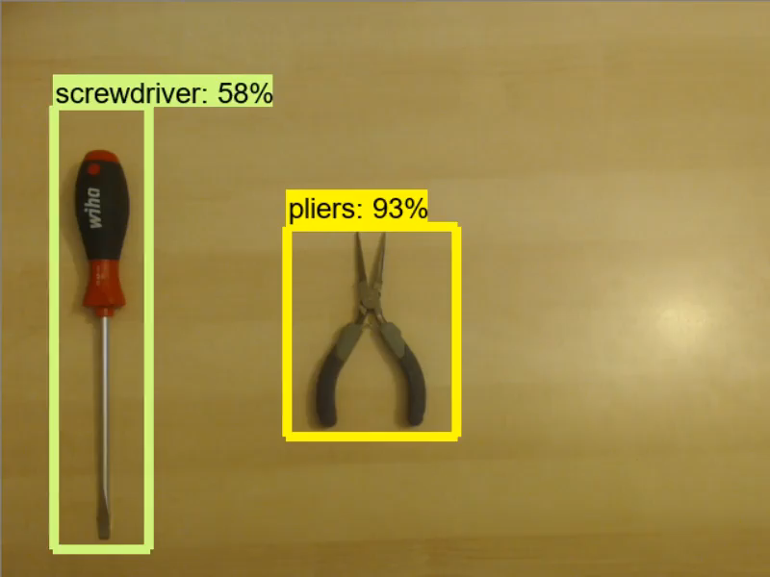
Real-time Detection (No Tracking)

Slide 15
Object Tracking

Slide 16
What is Object Tracking?
Object tracking is successively locating a known object in each frame of a video
Predefined bounding box is used as input to the tracker
Tracking is based on combining a motion model and an appearance model
Motion model is modeling the location and velocity of the object, like a Kalman filter
Appearance model is the model of the object to be tracked.
Frequently a classifier that is trained online
Notes:
What we’ve been talking about so far is object detection, which goes frame-by-frame and identifies if an object is in the frame, drawing a bounding box around each detected object. However, we also wanted to incorporate object tracking. Much like object detection, object tracking is about finding a specific object in a frame of video. However, object tracking assumes that you know the initial bounding box, and that an object will be in each successive frame.
In the context of real-time object tracking, algorithms are split up into two aspects, a motion model and an appearance model. The motion model keeps track of position and velocity of an object, among other related aspects. The Kalman filter is a commonly used example of this.
The appearance model represents what the object to be tracked looks like. While a template could be used, most modern techniques use a classifier that is trained online to represent the object. This improves robustness.

Slide 17
Why Track?
Tracking algorithms are usually faster than detection algorithms
Detection algorithms have to start with no prior information about an object.
Tracking algorithms know the previous location and velocity of an object.
Tracking algorithms start to drift over time from accumulating errors
Tracking can frequently handle occlusion better
Tracking preserves the identity of an object
Notes:
So with the shown results of the object detection, why would a tracker be important to implement? Reasons primarily focus on three things.

Slide 18
Tracking Methods
OpenCV 3.2 has 6 types of online trackers:
AdaBoost-based:
Boosting: Uses AdaBoost, an ensemble learning method, to estimate the location.
Multiple Instance Learning (MIL): Similar to Boosting, but looks at a wider range of locations as positive identifications.
Kernelized Correlation Filters: Builds on MIL’s strategy of creating a large number of overlapping positive identifications.
Notes:
Adaboost: An ensemble learning method that uses a linear combination of week classifiers to create a strong classifier.
Boosting: have an ensemble of weak classifiers that use Viola and Jones, HoG, and Local Binary Pattern features. Weak classifiers choose whether or not the location is the object by modeling the prob dist with a KF technique. Decision is gotten from this using a threshold for Harr-like wavelets and using NN for histogram based features.
Use a linear combination of these classifiers to make a strong classifier, update with prediction as pos, surrounding background as negative.
Legacy, outperformed by other methods.
MIL: Same basic concept, but incorporates multiple positive detections using bagging techniques, instead of only training on one. Classifies based on bags, and returns positive if any element in the bag is positive.
KCF: KCF expands on MIL, using the fact that the multiple positive detections will likely have large overlapped section, allowing for some correlation properties to improve on MIL in both speed and accuracy. Details are too math heavy for this presentation. This would be the one to use in this category, but took too long to execute in practice for a pseudo-real time situation.

Slide 19
Tracking Methods, Continued
Other:
Medianflow: Looking at a set of points in a bounding box, uses Lucas-Kanade optical flow estimator for a motion model, filtering out bad results. Remaining boxes used to get the final bounding box.
Tracking, Learning, Detection (TLD): A different tracking algorithm is combined with a Fern Ensemble classifier, which updates the tracker when it veers off-track
Goturn: Uses neural networks pretrained on a variety of labeled tracking videos to track novel objects
Notes:
The other methods included in OpenCV use different methods separate from AdaBoost and its associated features.
Medianflow: By assuming that the difference between frames is small and approximately constant around the point of consideration, L-K finds the Least Squares estimator for the optical flow. L-K is the motion model, similar features are used as the AdaBoost-based trackers for appearance model.
TLD: fern refers to a hashing algorithm, used to generate histograms to be classified. In OpenCV, the tracking algorithm used is medianflow. Initial testing returned many false positives, so not currently using it. We periodically use a detector to update the box location, so this would be redundant as well.
Goturn: Learns generic tracking patterns from wide variety of training data offline, which is useful online. (learns underlying motion)

Slide 20
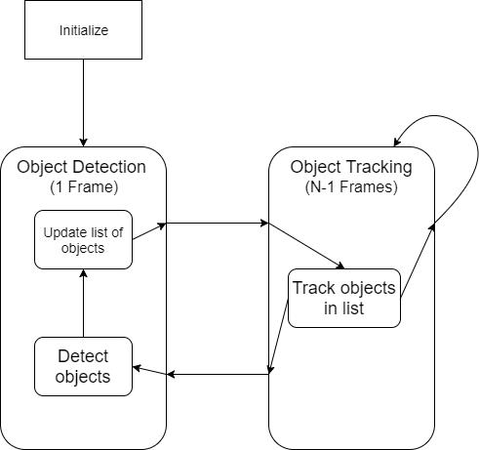
Incorporating Tracking
With OpenCV, tracking is fairly straightforward.
Preservation of ID is more complicated.
In detection phase, compare detections to list of objects.
If object doesn’t exist, add to new list.
Remove trackers that don’t match up with any detected objects.

Slide 21
Results and Conclusions

Slide 22
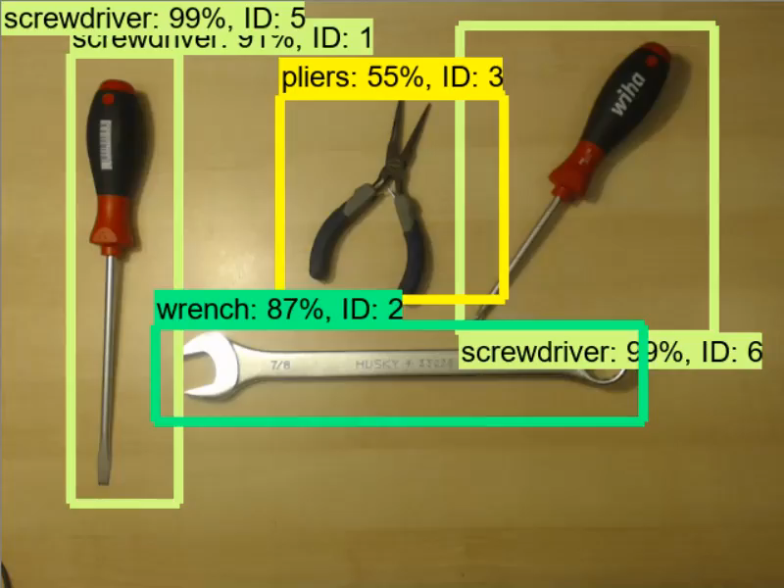
Real-Time Detection (Tracking)

Slide 23
Results
Collected and labeled new, tool-specific dataset
Used transfer learning to modify MobileNet-SSD classifier trained on the COCO dataset, for our tool dataset.
Implemented real-time object tracking using self-trained model.
50 FPS average
Incorporated medianflow-based tracking to improve fps and incorporate IDs.
110 FPS average, one object tracked.

Slide 24
Places to Improve
Detection
Augment some of the data (Kevin please add detail about that)
Wider variety of training images
More quantitative evaluation techniques
Precision-recall curve
F1 score
Tracking
Utilize more complex methods for tracking
Only managed to get KCF, medianflow working
Improve ID incrementing logic.
A number of parameters to tune that may make for more consistent IDs.
Notes:
Scale
Background
Some Tracking parameters include: margin of error between boxes before it’s considered a different box, maybe even using a different distance measurement between boxes (currently using max distance, but could use a 4 coordinate Euclidian/l2 norm), number of frames that

Slide 25
Future Work
Create a more complete training dataset.
More classes of tools
Explore alternate detection frameworks.
Inception V2 + Resnet
More exploration of tracking methods.
Goturn, TLD, KCF in practice
Hyperparameter tuning
Develop a user-facing frontend
Allow user to train new tools, train on their own tools.

Slide 26

Any Questions?

Slide 28
Layout: SectionDivider, Verdana Bold 40pt
Divider Subtext Verdana 28 pt

Slide 29
Layout: Title and Content Verdana Bold 32pt
First level bullet text, Verdana 24pt
Line spacing 0.95, before paragraph 12pt
Left justified
Sentence case
First level bullet color is accent1
Second level bullet Verdana 20pt
Line spacing 0.95, before paragraph 6pt
Third level
Third level
Fourth level

Slide 30
Layout: Two Content
First level bullet, Verdana 22pt
Line spacing 0.95, before paragraph 10pt
Left justified
Sentence case
First level bullet color is accent 1
Second level bullet
Third level
First level bullet, Verdana 22pt
Line spacing 0.95, before paragraph 10pt
Left justified
Sentence case
First level bullet color is accent 1
Second level bullet
Third level

Slide 31
Color Scheme
White–Background
R255 G255 B255
Accent 1
R171 G25 B45
Black
R0 G0 B0
Accent 2
R178 G183 B187
Red R171 G25 B45
Accent 3 R44 G106 B140
Grey
R109 G109 B109
Accent 4
R183 G160 B121
Accent 5 R70 G160 B220
Accent 6
R109 G109 B109

Slide 32
Default Settings
Theme Fonts:
Verdana (heading)
Verdana (body)
Drawing Style Default:
Sample
Sample
Sample
Text Box Default:
Verdana 16pt
Color: Black
Align: Center Line Spacing: Multiple .95 Space Before: 6pt
For labels only – use layout placeholders for bulleted lists
Line Style Default:

Slide 33
Default Table Style
Heading 1 | Heading 2 | Heading 3 | Heading 4 | Heading 5
Content | Content | Content | Content | Content
Content | Content | Content | Content | Content
Content | Content | Content | Content | Content
Content | Content | Content | Content | Content

Slide 34
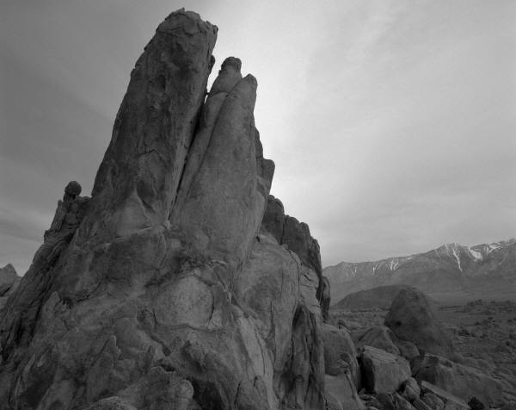
Layout: PhotoCaption
Photo description

Slide 35
Layout: Content Column Chart Sample
Notes:
BEST PRACTICES:
Open Excel 2007 before creating charts in PowerPoint
Duplicate this slide and edit data

Slide 36
Layout: Two Content Column Chart Sample
First level bullet text
Line spacing 0.95, before paragraph 12pt
Left justified
Sentence case
First level bullet color is accent 2
Second bullet level
Line spacing 0.95, before paragraph 6pt
Notes:
BEST PRACTICES:
Open Excel 2007 before creating charts in PowerPoint
Duplicate this slide and edit data

Slide 37
Layout: Content Line Chart Sample
Notes:
BEST PRACTICES:
Open Excel 2007 before creating charts in PowerPoint
Duplicate this slide and edit data

Slide 38
Layout: Two Content Line Chart Sample
First level bullet text
Line spacing 0.95, before paragraph 12pt
Left justified
Sentence case
First level bullet color is accent 2
Second bullet level
Line spacing 0.95, before paragraph 6pt
Notes:
BEST PRACTICES:
Open Excel 2007 before creating charts in PowerPoint
Duplicate this slide and edit data

Slide 39
Layout: Content Pie Chart Sample
Notes:
BEST PRACTICES:
Open Excel 2007 before creating charts in PowerPoint
Duplicate this slide and edit data

Slide 40
Layout: Two Content Pie Chart Sample
First level bullet text
Line spacing 0.95, before paragraph 12pt
Left justified
Sentence case
First level bullet color is accent 2
Second bullet level
Line spacing 0.95, before paragraph 6pt
Notes:
BEST PRACTICES:
Open Excel 2007 before creating charts in PowerPoint
Duplicate this slide and edit data

